Slide 1
Analog Project
Automatic Solar Tracker
Group 10
February 27, 2023

Slide 2
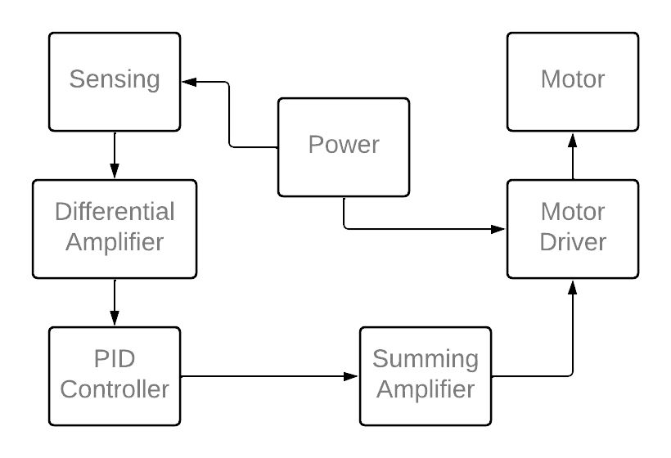
Block Diagram

Slide 3
Design Parameters
Reference Voltage – 12V
Light Sensor – 12mm LDR Dark Resistance: 1MΩ Light Resistance: 5-10 KΩ
OPAMPs - UA741CP, LMC660CN, TLC372CP
Motor Driver - L298N
Motor – RK-370CA-18260 DC Motor
Motor Stall Current 300 mA
PCB - 4 Layer, Manufactured and imported from JLC PCB (China)
Enclosure Material - Wood

Slide 4
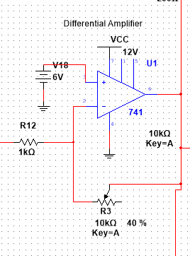
Differential Amplifier
Here the differential voltage between the input
voltage and set point voltage(6V) is being amplified.

Slide 5
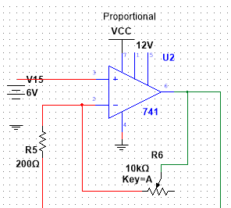
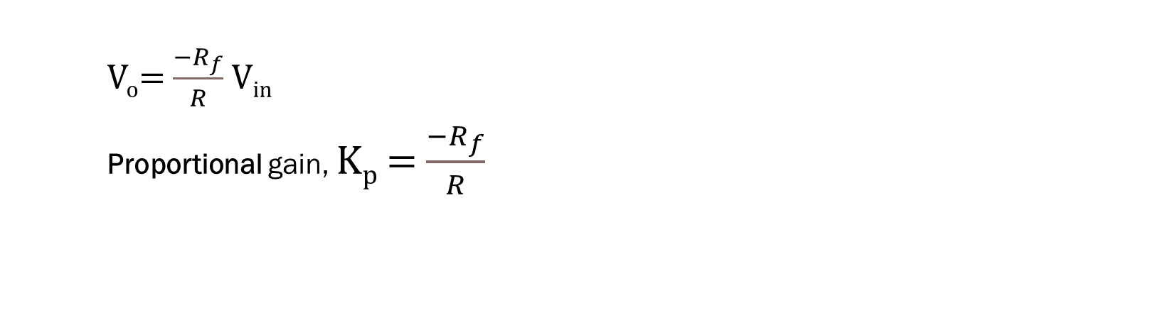
PID Controller
V_{o}= $\frac{−R_{f}}{R}$ V_{in}
Proportional gain, K_{p} = $\frac{−R_{f}}{R}$

Slide 6
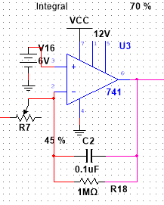
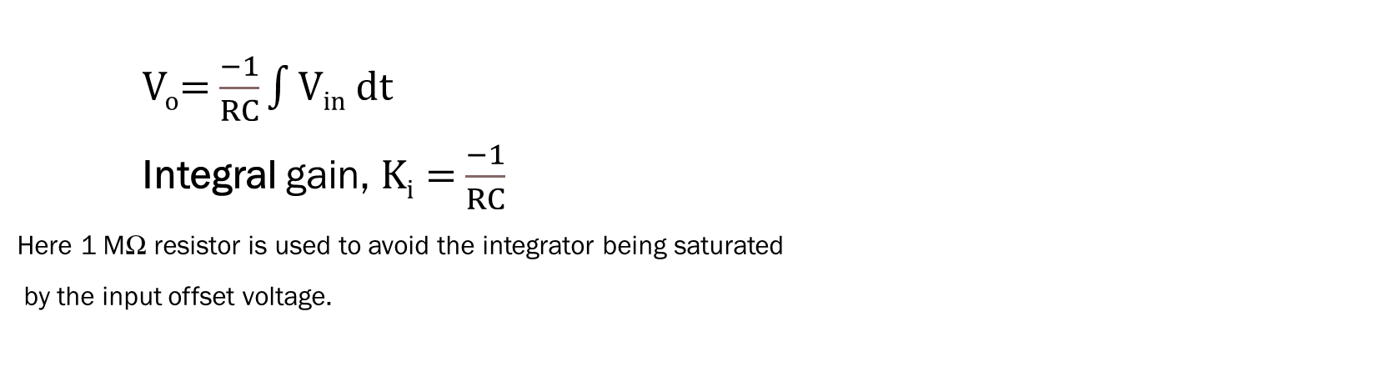
PID Controller
V_{o}= $\frac{−1}{RC}\int{Vin dt}$
Integral gain, K_{i} = $\frac{−1}{RC}$
Here 1 MΩ resistor is used to avoid the integrator being saturated
by the input offset voltage.

Slide 7
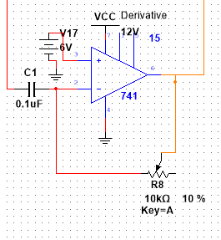
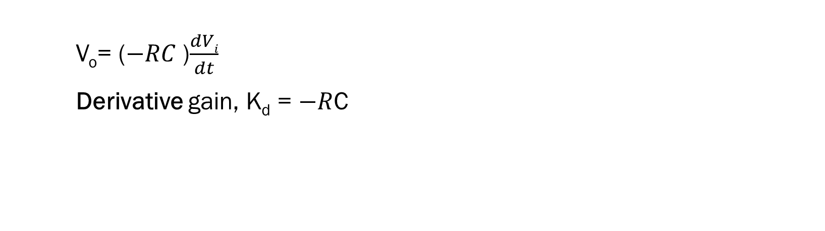
PID Controller
V_{o}= ($−RC$)$\frac{dVi}{dt}$
Derivative gain, K_{d} = $−R$C

Slide 8
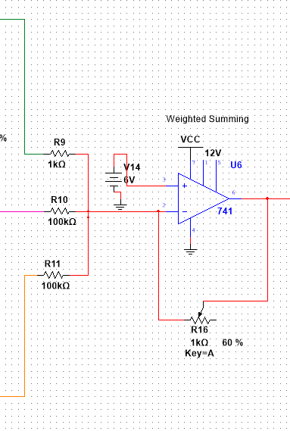
Weighted Summing Amplifier
P,I,D controller outputs are weighted and summed by this.
Here, larger resistors are used for I and d controllers as
their effect needs to be reduced appropriately for the smooth
operation of PID controller.

Slide 9
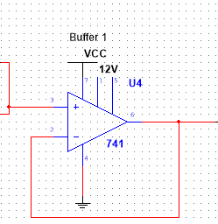
Voltage Buffers
Voltage buffers are used in our circuit to isolate the input
stage from output stage. We have used a OpAmp with higher
Input impedance.

Slide 10
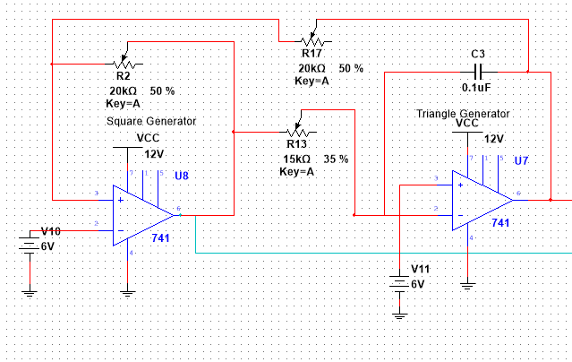
Triangular Wave Generation
The triangular wave form between 0-12V with 500Hz frequency is generated using the Schmitt trigger and integrator.
Here frequency of the waveform is adjusted by varying R₁₃.
The threshold voltage is adjusted keeping R₂/R₁₇ nearly equal to unity so that nearly 0-12V amplitude variation is possible.

Slide 11
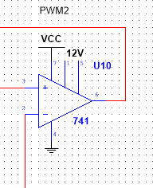
PWM Generation
PWM waves corresponding to the control signal from PID controller is created by the comparator with triangular waveform.

Slide 12
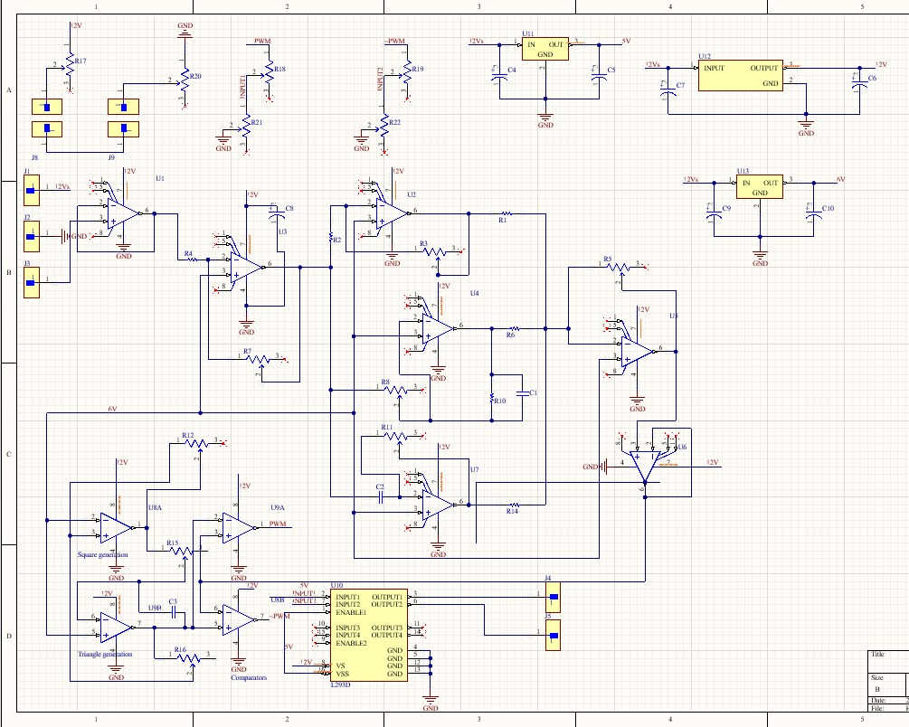
Schematic

Slide 13
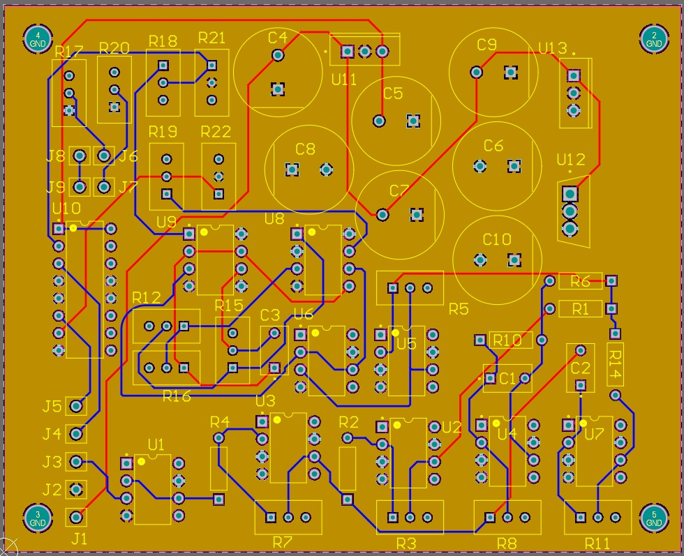
PCB

Slide 14
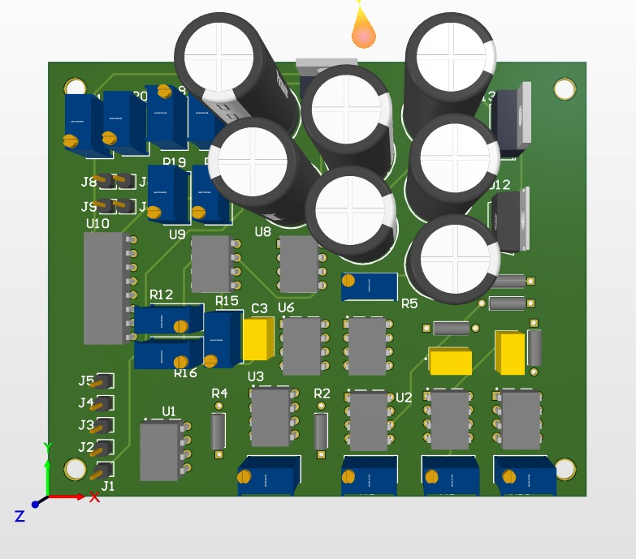
PCB 3D

Slide 15
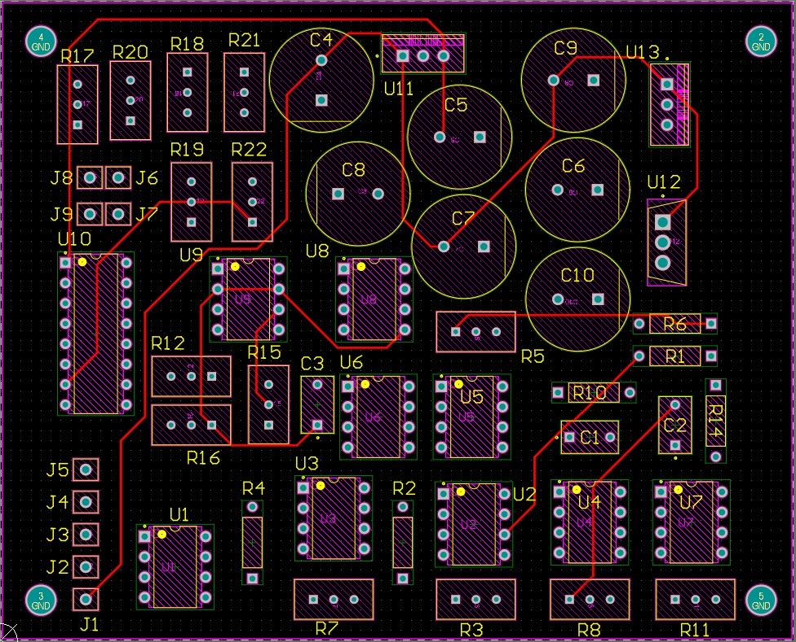
PCB Top Layer

Slide 16
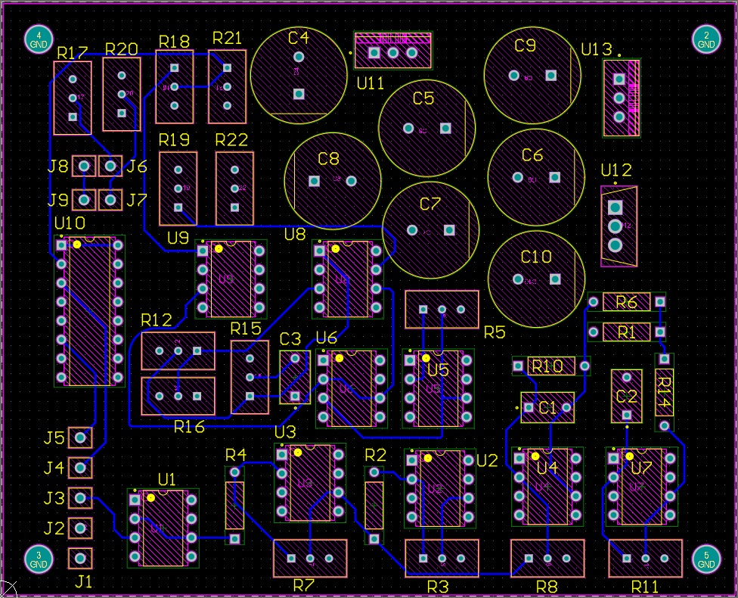
PCB Bottom Layer

Slide 17
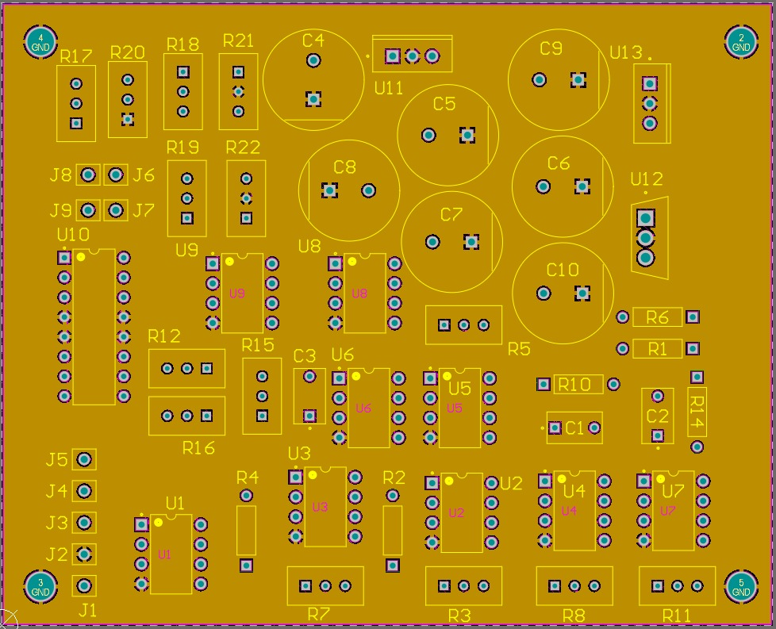
PCB Layer 1

Slide 18
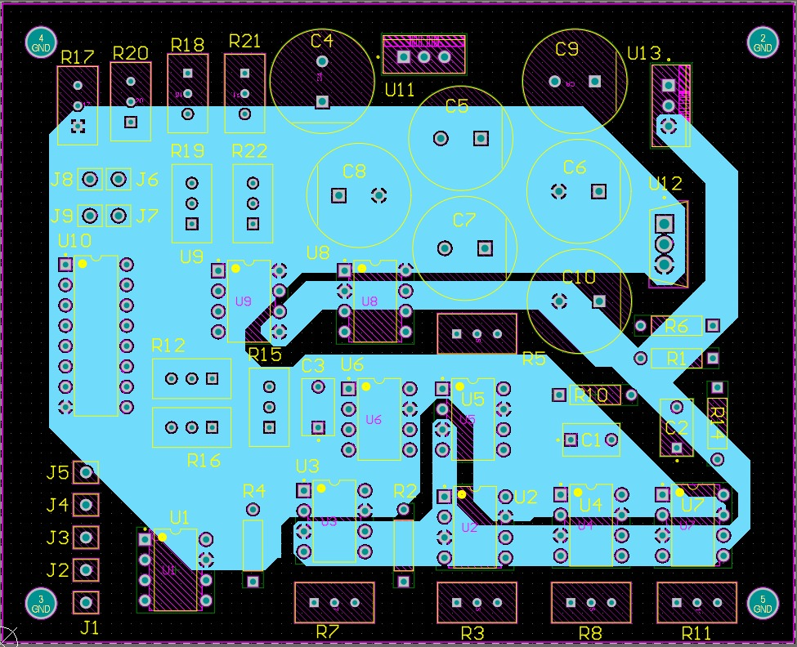
PCB Layer 2

Slide 19
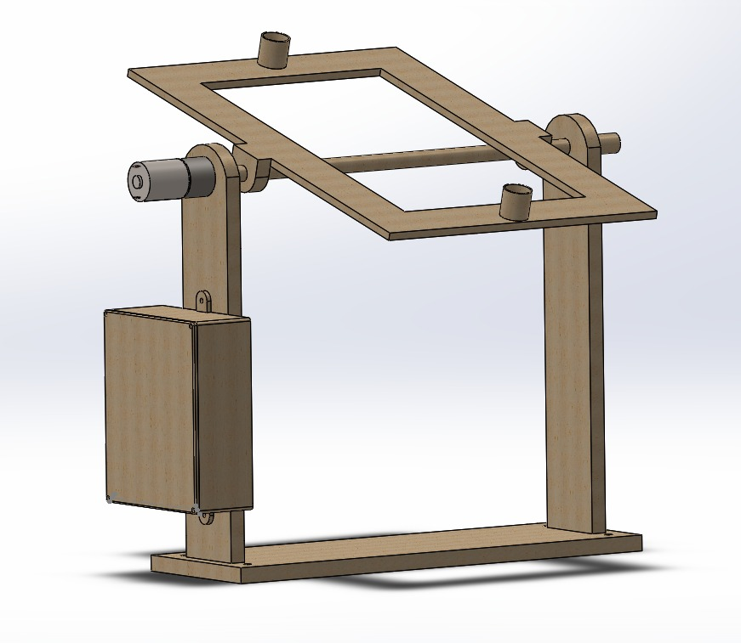
Enclosure

Slide 20
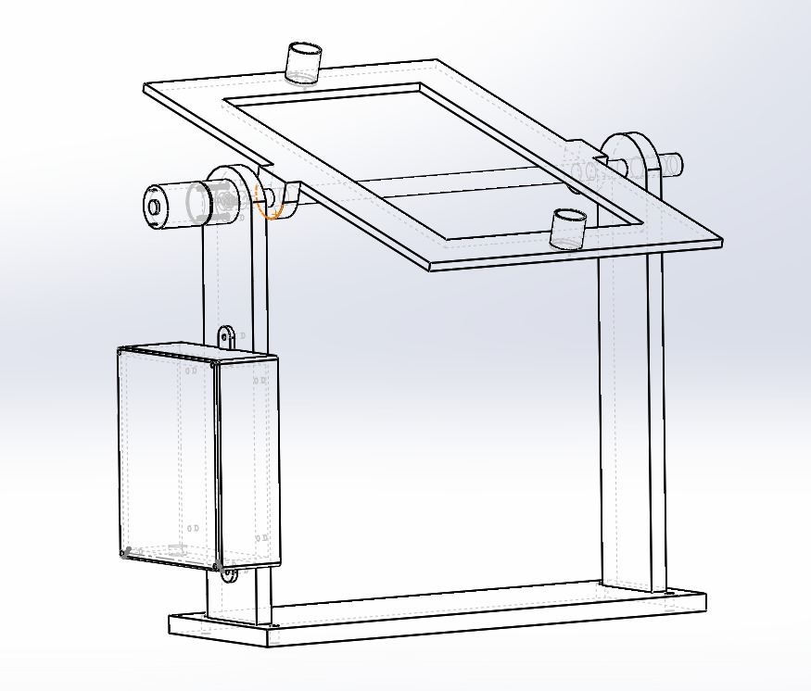
Enclosure

Slide 21
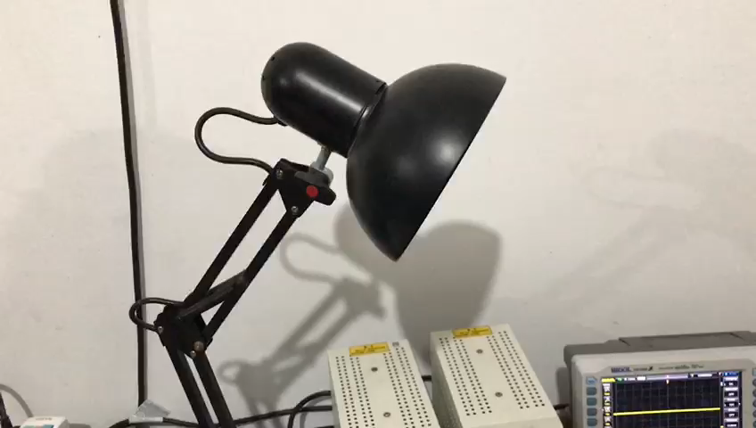
While Tuning

Slide 22
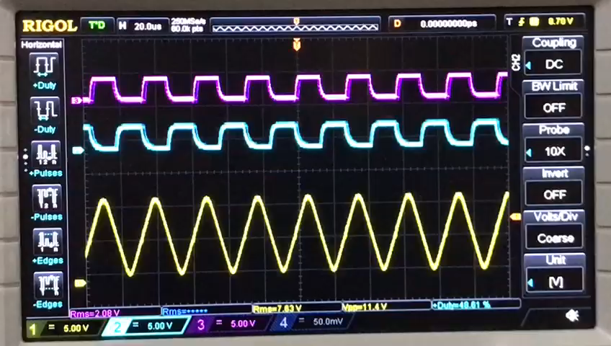
While Tuning

Slide 23
Future Works
MORE TUNING!
As the systems only draws around 1.4 W, the system can be developed to be powered by a solar panel.
To include a motor driver with a higher current capability.
Buck converter. To reduce power wastage.

Slide 24
THANK YOU

